Slide 1

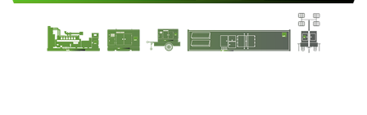
DRIVE THE DREAM
POWER THE FUTURE
COMPREHENSIVE SOLUTIONS FOR POWER GENERATION

Slide 2
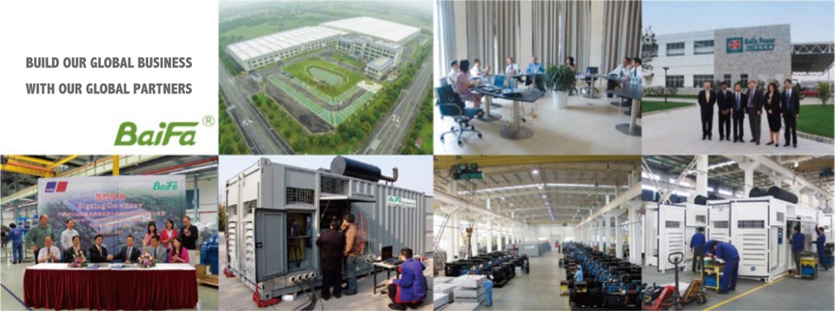

WELCOME TO BE PART OF BAIFA TEAM
Notes:
IN THE PAST 32 years, Baifa build our global business together with our global partners.

Slide 3

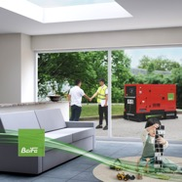
BAIFA, located in Wuxi XISHAN National High-Tech Industrial Development Zone, owns one of the largest manufacturing bases of generating set in Asia.
Over the past 32years, Baifa devoted itself into researching, manufacturing products and tailor services on a ‘ONE STOP’ comprehensive solutions for power generation bases for our customers.
PRODUCT RANGE:
-Industrial diesel and gas generator sets range from 8kWto 3200KW.
-Marine generator set from 40kW to 1100kW
-4 types of lighting towers
-LV&HV SWITCH PANEL up to 35kV
-TRANSFORMERS up to 110kV
-POWER GENERATION ACCESSORIES
ABOUT BAIFA

Slide 4
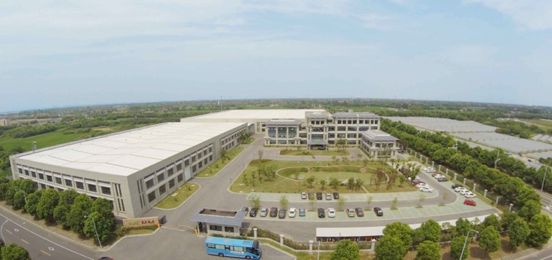
BAIFA GROUP
BAIFA POWER (WUXI) LTD.
HUAXUN EMERGENCY EQUIPMENT LTD.
BAIFA INTERNATIONAL ENGINEERING
TITLIS POWER ENGINEERING (SINGAPORE)
OUR GROUP
Notes:
BAIFA GROUP
- Baifa power wuxi for main manufacturer activities and trading.
- Titlis power Singapore for trade and overseas origin generator units
Baifa power international for engine import and trading
Baifa power engineering for EPC and rental

Slide 5

The success story of our business and product for past 32 years relies on the spirit of our culture.
“ INTEGRITY & HONESTY”.
We pursuit solutions with great enthusiasm , customer needs are our priority and pay attention to required details.
BAIFA CULTURE

Slide 6
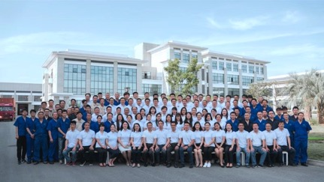
Number of employees: 180
Registered capital: 24 MILLION USD
Asset value: 300 Million RMB.
Production range:
Diesel/Gas industrial generator 8kW-3200kW,
Marine generator 40kW-1132kW,
lighting tower
LV&HV SWITCH PANEL up to 35kV
TRANSFORMERS up to 110kV
Production capacity: 5000-6000 units/year
Sales volume average: 70,000,000 USD/year.
Markets: More than 80 countries and regions.
ABOUT BAIFA

Slide 7
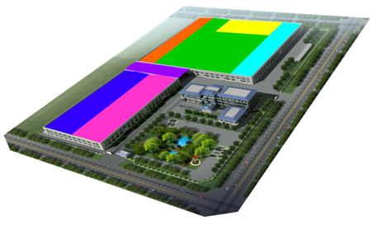
OVERALL FLOOR AREA: 60000 ㎡
WORKSHOP: 35000 ㎡
OFFICE BUIDLING: 5500 ㎡
sheet metal
production areas for gas gensets
warehouse
testing room
dispatch area
production areas for diesel gensets
semi-finished
products area
FACILITY

Slide 8
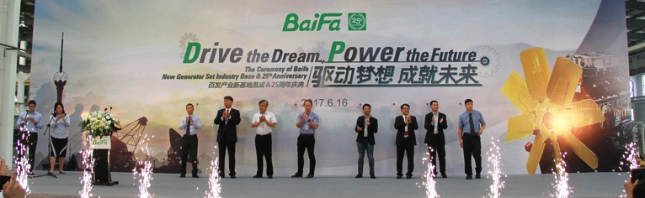
VISION:
Provide advanced and efficient electric energy solutions to all industry applications.
MISSION:
Our Mission ARS is to deliver
Accessible, Reliable, and Sustainable
power generation anywhere on our planet together with our extensive dealership network worldwide.
VISION & MISSION
Notes:
A
We’re committed to enhancing service & product quality, flexibility and efficiency, aiming to reduce capital and operational expenditures associated with owning BF power generators.
R
By continually innovating for solutions, we strive to maximize generator capabilities & flexibilities to provide reliable power supplies in diversified environments while expend it’s lifespan.
S
Integrating leading technologies to minimize fossil fuel consumption and COx/NOx emissions for every kilowatt-hour produced, safeguarding our precious natural environment.

Slide 9
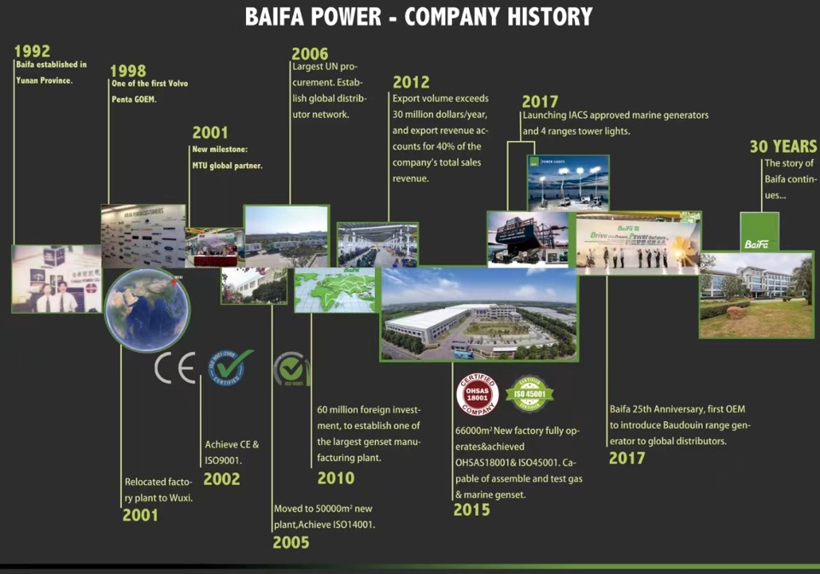
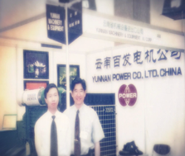
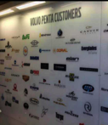
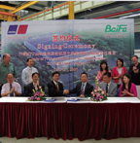
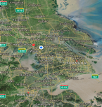
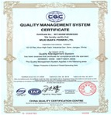
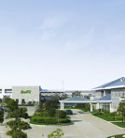
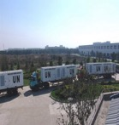
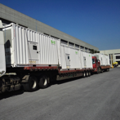
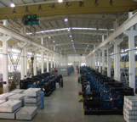
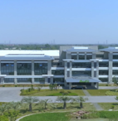

EST.1992
1998
2001
2001
2002
2005
Baifa established in Yunan Province.
One of the first Volvo Penta GOEM
New milestone:
MTU global partner
Relocated factory plant to Wuxi.
Achieve CE & ISO9001
Moved to 50000m² new plant. Achieve ISO14001
2006
2010
2012
2015
\
2017
Largest UN procurement. Establish global distributor network
60 million foreign investment, to establish one of the largest genset manufacturing plant.
Export reach 30m/yr USD, Export 40% of company sales revenue.
New factory fully operates&achieved ISO 18001. Capable of assemble and test gas & marine genset.
Baifa 25th Anniversary. New series Marine gensets and lighting towers. Improved product and market range.
ABOUT BAIFA
Notes:
2024 32 years EXPORT reached over 65 million USD/year

Slide 10
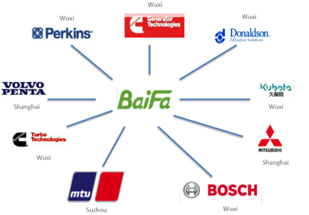
BAIFA, located in Wuxi XISHAN National High-Tech Industrial Development Zone, known as area of the world manufacture center as it gathers Baifa most main suppliers:
Perkins, VOLVO PENTA, Cummins Stamford, MTU, Mitsubishi and etc.
35 mins to Shanghai by Train
40 mins to Wuxi International airport, 15mins to train station
3 hours drive to sea port
ABOUT BAIFA

Slide 11

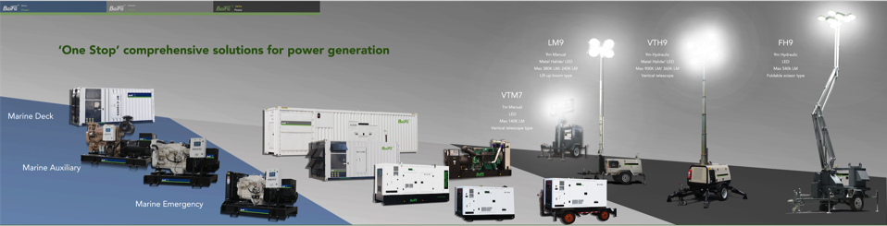
Baifa marine generator range offers:
Marine Auxiliary, Marine Emergency and Marine deck/harbor generator for all kinds of vessel power application.
CCS certified as standard.
Baifa Industrial generator range offers:
Wide range of capacity, engine and type solutions for every kinds of industrial application.
Baifa lighting towers
offers:
Four types series of tower to suit different types of construction, events and mining illumination needs.
UNLEASE THE POWER OF ENGINE

Slide 12
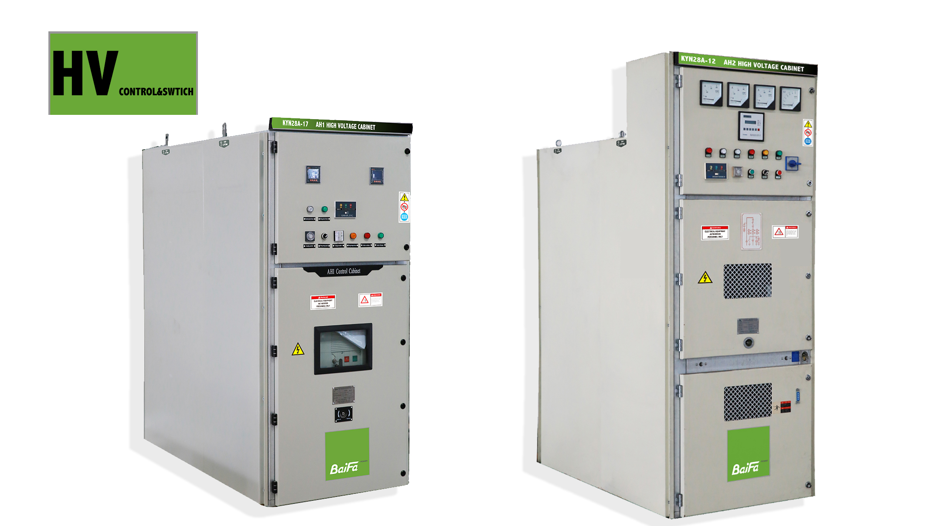
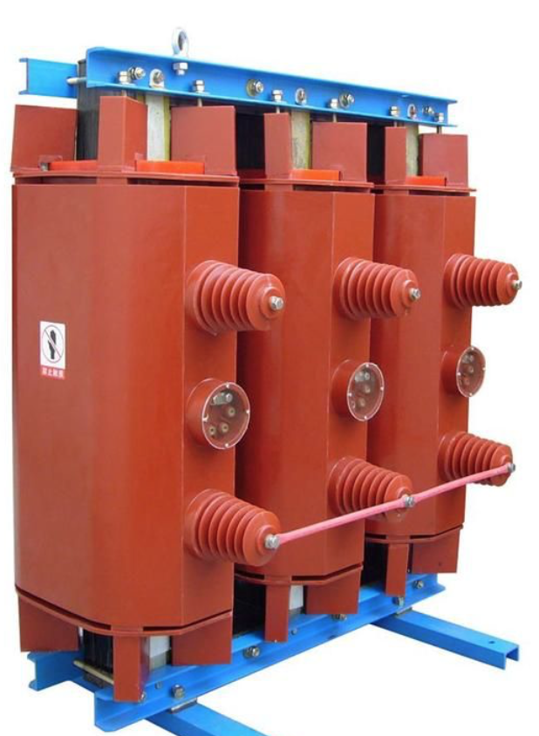
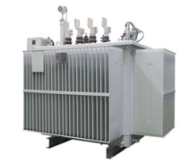
PANELS
LV low voltage switch panels
HV high voltage switch panels up to 35kV
TRANSFORMERS
Oil immersed type transformers up to 110KV
Dry type transformers up to 35kV
American standard box type substation
Euro standard box type substation
HV&LV SWITCH PANELS & TRANSFORMERS

Slide 13
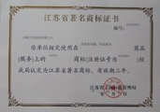




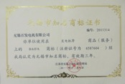
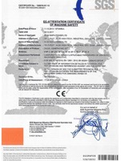
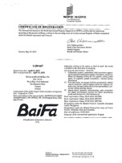


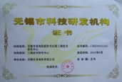
CERTIFICATIONS
State famous trademark
ISO9001
ISO14001
ISO18001
Wuxi city famous trademark
CCS certificates
for marine generator and container
CE
Baifa
Global trademark
Wuxi certified R&D Institutions
Notes:
BAIFA manufacturer plant management and quality assurance under above standards, including xxxxx

Slide 14




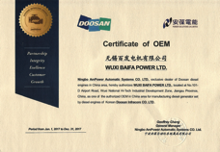
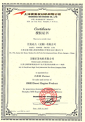
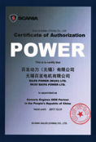


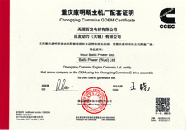

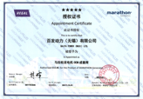
CERTIFICATIONS
Volvo Penta
MTU
Perkins
Stamford
Doosan
SME-Mitsubishi
Scania
Meccalte
Leory Somer
CCEC-Cummins
DCEC-Cummins
Marathon
Notes:
We only provide generator under OEM certification, which guarantees genuine components, global warranty&service and manufacture process under OEM guidance to insurance long lifespan quality.

Slide 15
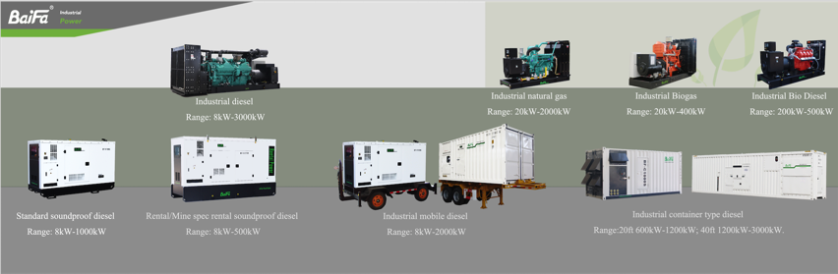
INDUSTRIAL GENERATOR TYPES
* Baifa offers various types of standard power generator products for customer’s choice or meet project demand.
* Above mentioned is standard products only, for special or customized requirement please contact Baifa sales for enquiry.
Notes:
OPEN TYPE to SOUNDPROOF WEATHERPROOF CANOPY/CONTAINER TYPE to TRAILER MOUNTED TYPE

Slide 16
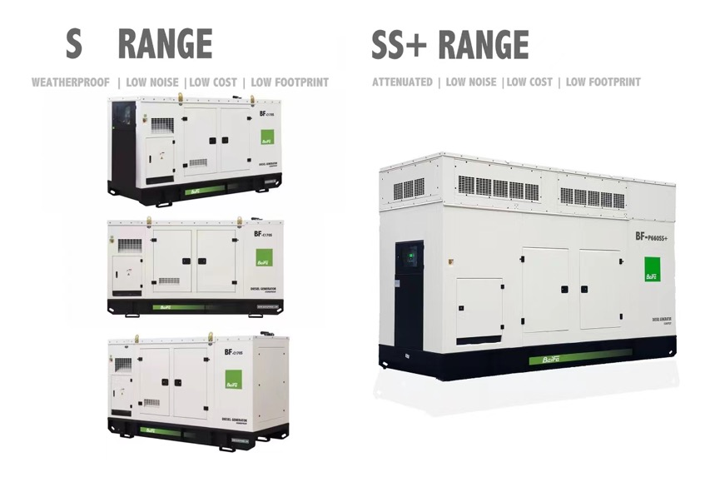
INDUSTRIAL GENERATOR TYPES
Notes:
S CANOPY
FEATURES: STANDARD BAIFA DISTRIBUTOR TYPE
RANGE: 8-1500kVA
SS+ CANOPY
FEATURES: UPGRADE BASED ON S, LOWEST NOISE WITH LOW FOOTPRINT
RANGE: 300-700kVA

Slide 17
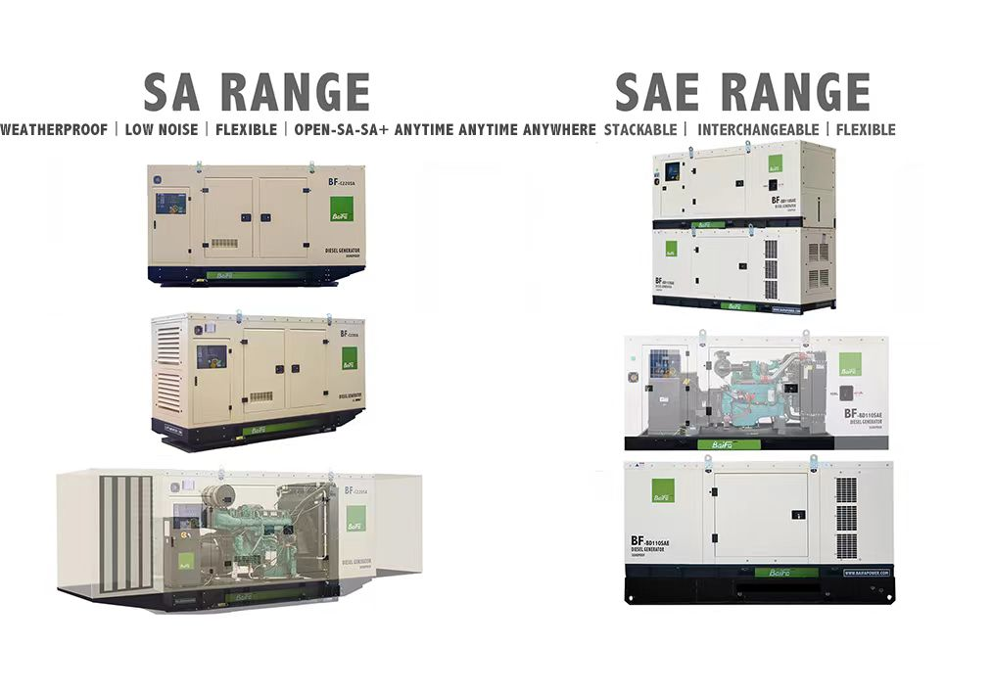
INDUSTRIAL GENERATOR TYPES
Notes:
SA CANOPY
FEATURES: INTERCHANGEABLE BETWEEN OPEN AND SOUNDPROOF FOR STOCK, FLEXIBLE TO UPGRADE IP LEVEL & NOISE
RANGE: 300-1500kVA
SAE CANOPY
FEATURES: STACKABLE, INTERCHANGEABLE BETWEEN OPEN AND SOUNDPROOF, AND FLEXIBLE TO UPGRADE FUEL TANK FOR TELECOM OR RENTAL APPLICATIONS.
RANGE: 25-150kVA

Slide 18
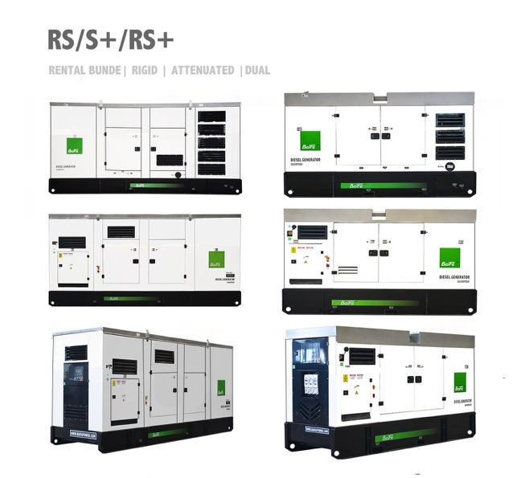
INDUSTRIAL GENERATOR TYPES
Notes:
RS CANOPY
FEATURES: DESIGNED FOR RENTAL
RANGE: 25-700kVA
S+ CANOPY
FEATURES: ATTENUATED AIR INTAKE AND DISCHARGE, 2.5mm CANOPY, DUAL SILENCER
RANGE: 25-700kVA
RS+ CANOPY
FEATURE: DESIGNED FOR RENTAL WITH LOW NOISE REQUIREMENT
RANGE 25-700kVA
RSL+ CANOPY
FEATURE: SINGLE POINT LIFTING, DESIGNED FOR RENTAL WITH LOW NOISE REQUIREMENT
RANGE 25-700kVA

Slide 19
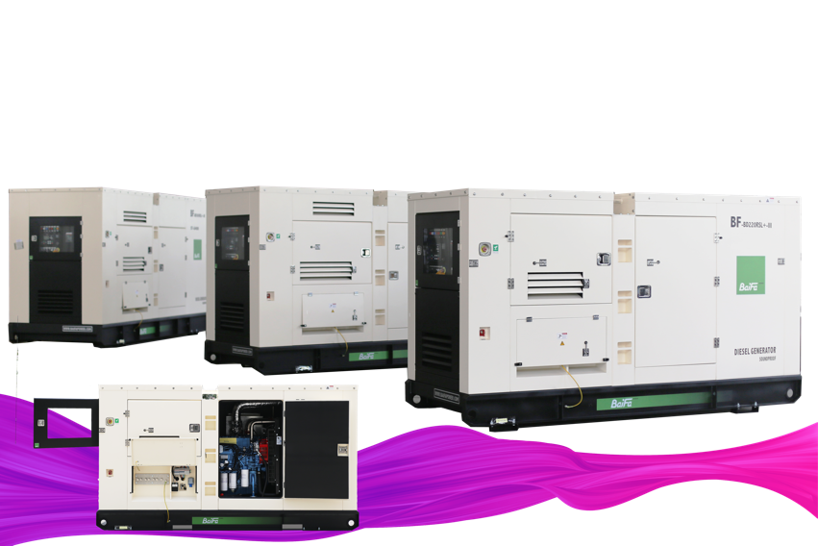
INDUSTRIAL GENERATOR TYPES
RSL+
SINGLE POINT LIFTING | DESIGNED FOR RENTAL WITH LOW NOISE REQUIREMENT
Notes:
RS CANOPY
FEATURES: DESIGNED FOR RENTAL
RANGE: 25-700kVA
S+ CANOPY
FEATURES: ATTENUATED AIR INTAKE AND DISCHARGE, 2.5mm CANOPY, DUAL SILENCER
RANGE: 25-700kVA
RS+ CANOPY
FEATURE: DESIGNED FOR RENTAL WITH LOW NOISE REQUIREMENT
RANGE 25-700kVA
RSL+ CANOPY
FEATURE: SINGLE POINT LIFTING, DESIGNED FOR RENTAL WITH LOW NOISE REQUIREMENT
RANGE 25-700kVA

Slide 20
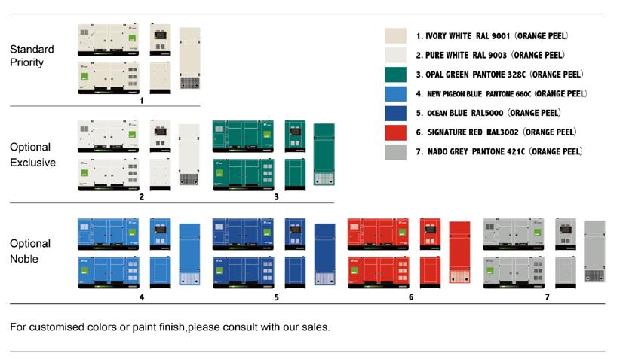
INDUSTRIAL GENERATOR TYPES

Slide 21
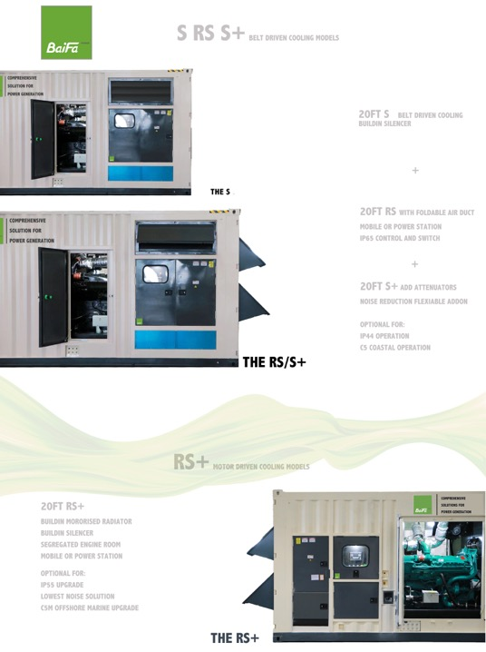
INDUSTRIAL GENERATOR TYPES
Notes:
S CONTAINER
FEATURES: STANDARD SOUNDPROOF
RANGE: 20ft GP 750-1125kVA; 20ft HC 1250-1500kVA; 40ft HC 1500kVA ABOVE
RS CONTAINER
FEATURES: RENTAL SOUNDPROOF, AIR INTAKE&DISCHARGE FOLDABLE AIRDUCT IMPROVE IP LEVEL AND NOISE ; WALL MOUNT BREAKER AND CONTROL FOR LOW NOISE OPERATION;
RANGE: 20ft GP 750-1125kVA; 20ft HC 1250-1500kVA; 40ft HC 1500kVA ABOVE
S+ CONTAINER
FEATURES: INCLUDES ALL RS FEATURES, UPGRADE INTERNAL INTAKE&DISCHARGE ATTENUATOR, UPGRADE TOP AIR DISCHARGE
RANGE: 20ft HC 750-1125kVA; 40ft HC 1500kVA ABOVE
RS+ CONTAINER
FEATURES: LOWEST NOISE SOLUTIONS; INCLUDES ALL RS FEATURES; UPGRADE MOTOR DRIVEN RADIATOR WITH ENIGNE ROOM SEGREGATION.
OPTIONAL FEATURES:
-FURTHER UPGRADE NOISE: ENGINE ROOM MOTOR DRIVEN FAN; SUPER SILENT MOTOR; INTAKE INTERNAL AIRDUCT+ATTENUATOR
-FURTHER SAVE FUEL AND LOWER NOISE ON VARIABLE LOAD: VSD DRIVE
-FURTHER IMPROVE IP LEVEL: G3 AIRFILTER IMPROVE ENGINE ROOM IP54
RANGE: 20ft HC 750-1500kVA; 40ft HC 1500kVA ABOVE

Slide 22
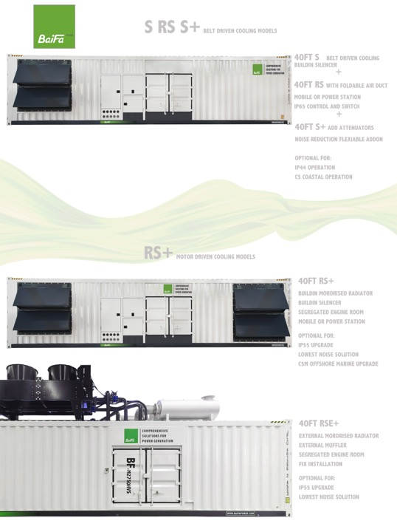
INDUSTRIAL GENERATOR TYPES
Notes:
S CONTAINER
FEATURES: STANDARD SOUNDPROOF
RANGE: 20ft GP 750-1125kVA; 20ft HC 1250-1500kVA; 40ft HC 1500kVA ABOVE
RS CONTAINER
FEATURES: RENTAL SOUNDPROOF, AIR INTAKE&DISCHARGE FOLDABLE AIRDUCT IMPROVE IP LEVEL AND NOISE ; WALL MOUNT BREAKER AND CONTROL FOR LOW NOISE OPERATION;
RANGE: 20ft GP 750-1125kVA; 20ft HC 1250-1500kVA; 40ft HC 1500kVA ABOVE
S+ CONTAINER
FEATURES: INCLUDES ALL RS FEATURES, UPGRADE INTERNAL INTAKE&DISCHARGE ATTENUATOR, UPGRADE TOP AIR DISCHARGE
RANGE: 20ft HC 750-1125kVA; 40ft HC 1500kVA ABOVE
RS+ CONTAINER
FEATURES: LOWEST NOISE SOLUTIONS; INCLUDES ALL RS FEATURES; UPGRADE MOTOR DRIVEN RADIATOR WITH ENIGNE ROOM SEGREGATION.
OPTIONAL FEATURES:
-FURTHER UPGRADE NOISE: ENGINE ROOM MOTOR DRIVEN FAN; SUPER SILENT MOTOR; INTAKE INTERNAL AIRDUCT+ATTENUATOR
-FURTHER SAVE FUEL AND LOWER NOISE ON VARIABLE LOAD: VSD DRIVE
-FURTHER IMPROVE IP LEVEL: G3 AIRFILTER IMPROVE ENGINE ROOM IP54
RANGE: 20ft HC 750-1500kVA; 40ft HC 1500kVA ABOVE

Slide 23
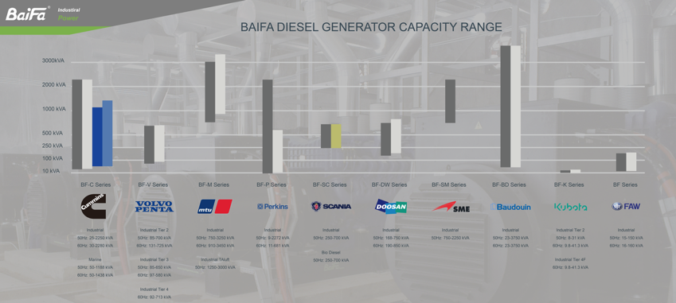
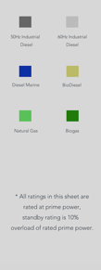
GENRATOR POWER DIESEL RANGE
* Baifa offers wide range of Industrial diesel, natural gas and marine power generator products for customer’s choice or meet project demand.
* Above mentioned is standard power range only, for special requirement please contact Baifa sales for enquiry.
Notes:
BAIFA COMPETITIVE DIESEL PRIME RANGE: CUMMINS, VOLVO, MTU
BAIFA COMPETTIVE DIESEL STANDBY RANGE: BAUDOUIN, DOOSAN, SME
BIODIESEL: SCANIA
MARINE: CUMMINS

Slide 24


BF-C CUMMMINS POWERED
25-2500kVA WIDE RANGE IDEAL FOR STOCK/RENTAL
LOW OPERATIONAL COST
PARTS ACCESSIBITILIES
GLOBAL WARRANTY AND SERVICE
EMISSION RANGE:
NON-EMISSION
Q RANGE CHINA STAGE3/STAGE3A/TIER 3 FOR 560kW BELOW
Q RANGE CHINA STAGE3/TIER 2 FOR 560kW ABOVE
GENRATOR POWER DIESEL RANGE

Slide 25
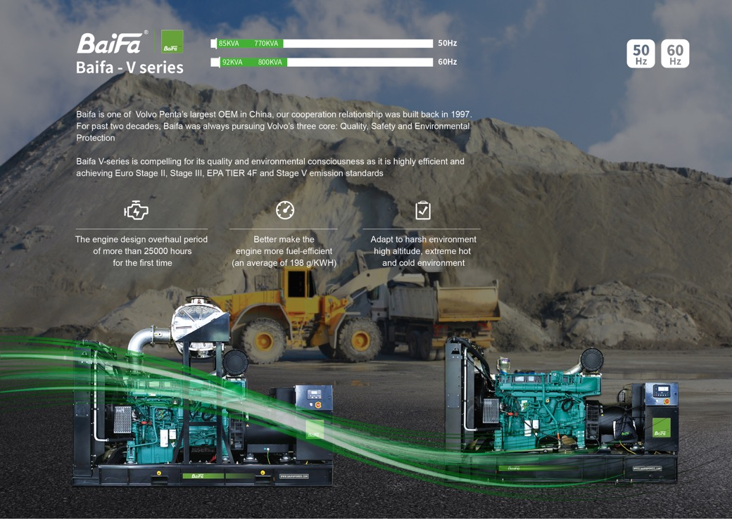
BF-V VOLVO PENTA POWERED
200-750kVA MEDIUM RANGE
TWIN 1000kVA/1300kVA/1400kVA
LOWEST FUEL CONSUMPTION
TWICE LONGER SERVICE & OVERHAUL INTERVAL
55 DEGREE RADIATOR AS STANDARD
FULL RANGE G3 CLASS
LOW NOISE & FOOTPRINT
PARTS ACCESSIBITILIES
GLOBAL WARRANTY AND SERVICE
SWEDEN ORIGIN
TAILORED FOR:
HIGH END CONTINUOUSPRIME/STANDBY MEDIUM SIZE FACILITY
HIGH EMISSION REQUIREMENT RENTAL
HIGH ALTITUDE/AMBIENT APPLICATION
EMISSION RANGE:
STAGE 2/ TIER2
STAGE 3A/ TIER3
TIER4I/F
STAGE V
GENRATOR POWER DIESEL RANGE

Slide 26
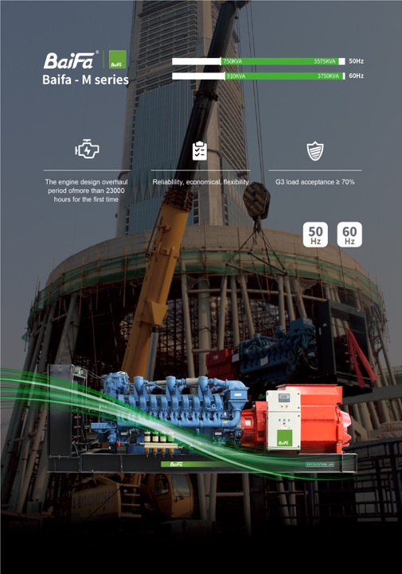
BF-M MTU ROLLS-ROYCE POWERED
750KVA-3575kVA HIGH RANGE
LOWEST FUEL CONSUMPTION IN ITS RANGE
LOW OPERATIONAL COST
TWICE LONGER SERVICE & OVERHAUL INTERVAL
PARTS ACCESSIBITILIES
FULL RANGE G3 CLASS
GLOBAL WARRANTY AND SERVICE
OFFERS GERMANY&CHINA ORIGIN
TAILORED FOR PROJECT APPLICATIONS
POWER STATION 3A
STANDBY 3D
PRIME 3B/3E
DATA CENTER CONTINUOUS 3F
GRID STABLIZATION POWER 3G
HIGH ALTITUDE APPLICATION
EMISSION RANGE:
NON-EMISSION FUEL PRIORITIES
EMISSION PRIORITY
TALUFT/SINGAPORE EMISSION/CHINA STAGE3/TIER 2
GENRATOR POWER DIESEL RANGE

Slide 27
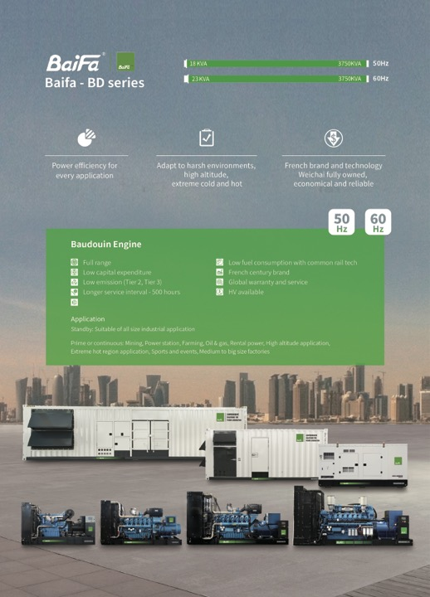
BF-BD BAUDOUIN POWERED
17KVA-4000kVA FULL RANGE SOLUTION
LOWEST CAPEX FOR STANDBY MARKET
PARTS ACCESSIBITILIES
FULL RANGE G3 CLASS
GLOBAL WARRANTY AND SERVICE
TAILORED FOR PROJECT APPLICATIONS
STANDBY
DATA CENTER CONTINUOUS
HIGH ALTITUDE
EMISSION RANGE:
NON-EMISSION FUEL PRIORITIES
EMISSION PRIORITY
TALUFT/SINGAPORE EMISSION/CHINA STAGE3/TIER 2
GENRATOR POWER DIESEL RANGE

Slide 28
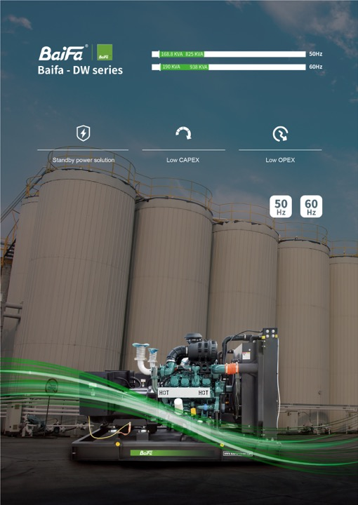
BF-DW DOOSAN POWERED
168kVA-1000kVA MEDIUM RANGE
LOW CAPEX
PARTS ACCESSIBITILIES
GLOBAL WARRANTY AND SERVICE
OFFERS KOREA ORIGIN
TAILOR FOR PROJECT APPLICATIONS
STANDBY MEDIUM SIZE FACILITY
EMISSION RANGE:
NON-EMISSION
GENRATOR POWER DIESEL RANGE

Slide 29
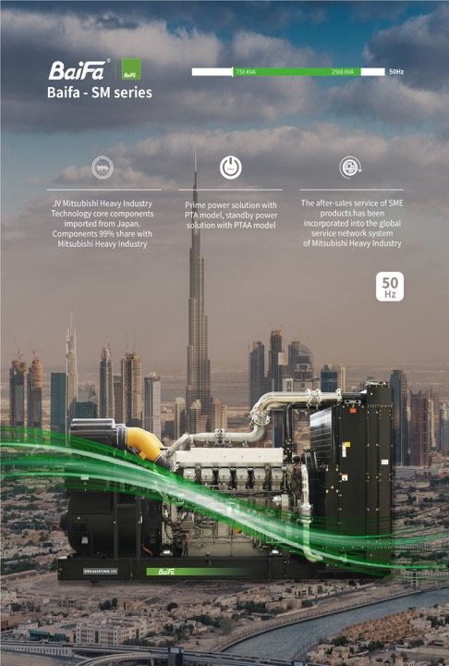
BF-SM/MH MITSUBISHI POWERED
750KVA-2500kVA HIGH RANGE
LOW CAPEX
PARTS ACCESSIBITILIES
PTA RANGE G3 CLASS
GLOBAL WARRANTY AND SERVICE
OFFERS CHINA&JAPAN ORIGIN
TAILOR FOR PROJECT APPLICATIONS
STANDBY
PTA RANGE PRIME&CONTINUOUS POWER STATION
EMISSION RANGE:
NON-EMISSION FUEL PRIORITIES
GENRATOR POWER DIESEL RANGE

Slide 30
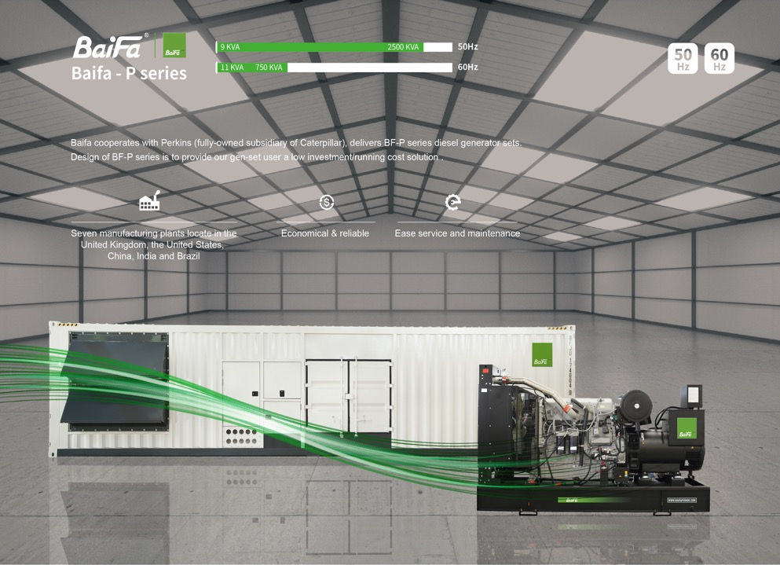
BF-P PERKINS POWERED
10KVA-2500kVA FULL RANGE
PARTS ACCESSIBITILIES
GLOBAL WARRANTY AND SERVICE
OFFERS UK/USA/INDIA/CHINA ORIGIN
TAILOR FOR PROJECT APPLICATIONS
STANDBY/PRIME
EMISSION RANGE:
NON-EMISSION FUEL PRIORITIES
STAGE3A/TIER 3 FOR 560KW BELOW
GENRATOR POWER DIESEL RANGE

Slide 31
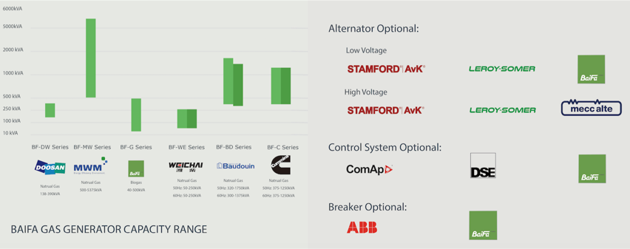

GAS RANGE
* Baifa offers wide range of Industrial diesel, natural gas and marine power generator products for customer’s choice or meet project demand.
* Above mentioned is standard power range only, for special requirement please contact Baifa sales for enquiry.

Slide 32


MARINE
RANGE
* Baifa offers wide range of Cummins powered marine power generator products for customer’s choice or meet each vessel demand.
* Above mentioned is standard power range only, for special requirement please contact Baifa sales for enquiry.
Notes:
BAIFA MARINE GENERATORS INCLUDES: AUXILIARY TYPE COOLED SEAWATER BY HEAT EXCHANGER; EMERGENCY TYPE COOL BY AIR VIA BELT DRIVEN RADIATOR WITH DUAL STARTING SYSTEM; MARINE DECK TYPE FOR PORT OR EMERGENCY APPLICATION.

Slide 33

DIESEL
LIGHTING RANGE
* Baifa offers wide range of Kubota／YANMAR engine powered lighting tower products for customer’s choice or meet each job or mine site demand.
Notes:
VTM7 MOST POPULAR MODEL FOR ROAD CONSTRUCTION AND CONSTRUCTION SITE. IT IS LOW FOOTPRINT, EASY TO MOVE AND LOW CAPEX&OPEX.
FH9 FOR HIGH DUTY MINING SITE, WITH MAX OF LIGHTS. HYDRAULIC MAST BOOM, HYDRAULIC LEGS AND HYDRAULIC MAST ROTATION. AVAILBLE IN DC SYSTEM.
LM9: TRADITIONAL BOOM FOR 9M. CAN FIT 22 UNITS IN ONE 40FT.
VTH9; MOST POPULAR HYDRAULIC MAST LIGHTING TOWER WITH ELECTRIC LIGHT TILT. AVAILBLE IN DC SYSTEM.

Slide 34

SOLAR
LIGHTING RANGE
* Baifa offers SOLAR BATTERY powered lighting tower products for customer’s choice or meet each job or mine site demand.
SOLAR/BATTERY SERIES | MODELS | HEIGHT | SOLAR | BATTERY | LIGHTS | TOTAL LM
VTM7 HYBRID | VTM7-E400 HYBRID | 7m | 3*435W | 4*100AH | 4*100W LED | 64000
 | VTM7-E800 HYBRID | 7m | 4*460W | 4*200AH | 4*200W LED | 136000

Slide 35



SINGLE UNIT
SYCHRONISE
CONTROLLER
Notes:
INTRODUCE BF SERIES CONTROLLER; BF61 FUNCTION=DSE6120; BF62 FUNCTION=DSE7320. MOST VALUE FOR MONEY ON OPERATION AND MAINTENANCE. AVAILBLE IN DISTRIBUTOR.

Slide 36





TURNKEY ACCESSORIES TRANSFORMER/CABLE/ATS/HV PANEL/ HV GENERATOR/ LOADBANK

Slide 37

PROJECT CASE STUDIES

Slide 38


HIGH VOLTAGE BACK-UP POWER. SAMSUNG: FACTORY
2013 SAMSUNG FACTORY, CHINA
Genset model: BF-M2500HV Standby power: 2500kVA, 10.5KV
Quantity: 4 units
In 2013, Baifa provided auto transferred, auto paralleled high-voltage 10.5KV diesel gen-sets and auto-control system powered by four 2000KW MTU engine, total capacity reached 8MW.
MTU engine has world most advanced fuelling system and injection system, technology allows MTU engines to have advantages on high reliability, fuel economic and low emission compare to other engines.
Notes:
BIGGEST SAMSUNG CITY IN CHINA, TOTAL 4+4 UNITS SUPPLIED.

Slide 39

HIGH-VOLTAGE BACK-UP POWER,TOYO: OFFICE BUILDING/FACTORY
2013, TOYO FACTORY, KOREA
Gen-set model: BF-M2000,HV-60 Standby power: 2200kVA, 6.9KV
Quantity: 4 units
In 2013, we provide 4 sets of 2000KW diesel generators as back-up power for Toyo Factory in Korea.
60Hz , 6.6KV high-voltage, fully auto controlled and paralleled
Notes:
SEMI-CONDUCT

Slide 40


HIGH-VOLTAGE PRIME POWER: FACTORY
Notes:
CHEMICAL PANT

Slide 41


HIGH-VOLTAGE PRIME POWER: FACTORY
2023 GLASS FACTORY BACKUP POWER
Gen-set model: BF-SM2250-HV Standby power: 2250kVA, 10.5KV
Quantity: 6 units
Notes:
CHEMICAL PANT

Slide 42


HIGH-VOLTAGE PRIME POWER: FACTORY
2015-2016 INDUSTRIAL ZONE, BENIN
Gen-set model: BF-M2500,HV
Prime power: 2000kVA, 22KV
Quantity: 5 units
Baifa provided a Benin customer 5 sets Germany MTU 2000KW container soundproof diesel gensets, with the whole system boosting to 22KV, used as main power supply on customer’s site.
Notes:
BAIFA OVERSEAS TURNKEY PROJECT. PROVIDES ALL ACCESSORIES FOR THE PROJECT.

Slide 43



HIGH-VOTAGE STANDBY POWER: BUILDING
2015, TALLEST HIGH RISE,
NORTHERN, CHINA
Gen-set model: 4*BF-M3250,HV
2*BF-M2750HV
1*BF-M2750
In 2015,Baifa supplied standby diesel generators to Tianjin 117 Building-the tallest building in North China.
The total height of the building is 597m,with 4 floors underground and 117 floors on the ground. This project totally applied:

Slide 44

HIGH-VOTAGE STANDBY POWER: BUILDING
2017, LOTUS TOWER, SRI LANKA
Gen-set model: BF-M2750HV
Standby power: 2500kVA
Quantity: 2
Baifa 2 units BF-M2750MV providing backup power for most iconic building in Colombo, Sri Lanka.
Notes:
CENTRAL ASIA TALLEST TOWER

Slide 45

STANDBY POWER: BUILDING
2018, MARINE GATE1, DUBAI, UAE
Gen-set model: BF-SM2100
Standby power: 1500kVA
Quantity: 1
Baifa BF-SM1650 providing backup power for most iconic building DUBAI MARINE.
Notes:
BAIFA IS THE FIRST TO INTRODUCT MITSUBISHI CHINA TO UAE PROJECT.

Slide 46



STANDBY POWER: HOTEL
2012-2015, MANGROVE HOTE, CHINA
In total 20MW emergency power was supplied to different sites of transnational hotel franchise Mangrove tree in Sanya city, China.
Notes:
LOTS OF 5 STARS HOTEL REFERENCE IN CHINA.

Slide 47


STANDBY POWER: HOTEL
Reference list:
Beijing Crown hotel (Below)
Sanya Hainan Red Forest Hotel
South Sanya Red Forest Hotel
Coral Hotel of Wuzhizhou Island Sanya
Jiujiang Mount Lu zuishi Spa Resort
Shishi Fujian Lvdao International Hotel Co. Ltd.
Qingdao Shandong Ocean Hotel
Banyan Tree Lijiang Yunnan Hotel
Suzhou Taihu Golf Hotel
V-Continent Beijing Parkview Wuzhou Hotel
Jianyang Sichuan Xin Yatu Hotel
Beijing canal people's founding Holiday Inn
Ibis Hotel
Baifa genset has been popular for it’s robust and low noise level, which allows our units to supply power for overseas famous hotels.(Below: Qatar –French Vinci group)
Notes:
LOTS OF 5 STARS HOTEL REFERENCE IN CHINA AND WORLD WIDE.

Slide 48

CONTINUOUS POWER: MINING
2013, MINE SITE PRIME, MONGOLIA
Gen-set model: BF-M2500SHV
Prime power: 2000kVA, 10.5KV
Quantity: 2 units
In 2012, Baifa provided 2 sets of BF-M series 2000KW containerized diesel generators, boosted and auto paralleled for prime power supply on Mongolia mining site.
Gen-set and electric transformer all contained in well built sand and all weatherproof 40ft container.
Notes:
IP55 SOLUTION TO PREVENT DUSTY MINING ENVIROMENT USING RS+ CONTAINER.

Slide 49

CONTINUOUS POWER: MINING
Mining project reference list in China:
Mangnai Xingyuan Potash Co. Ltd.
Xixinzhuang Town Coal Mine of Xiaoyi City in Shanxi Province
Sand Village Mining Co., Ltd. of Huzhou Zhejiang
Heilongjiang Long Peng Coal Co., Ltd.
Banmiao Mining Co.,Ltd. of Baishan Jilin
Mahai Yanhu Wansheng Potash Factory of Haixi Prefecture of Qinghai
Chenzhou Yongxing Nonferrous Metal Smelting Co., Ltd
Qiangxing Mining Co. Ltd. Of Loufan County in Taiyuan City
2011, MINE SITE PRIME, MONGOLIA
Genset model: BF-C825;
Prime power: 750kVA;
Quantity: 11 units

Slide 50

CONTINUOUS POWER: MINING
Genset model: BF-C2250QRS+
Prime power: 2000kVA;
Quantity: 3 units
2017,
SUDAN MINE
Notes:
IP55 SOLUTION TO PREVENT DUSTY MINING ENVIROMENT USING RS+ CONTAINER.

Slide 51

CONTINUOUS POWER: MINING
Genset model: BF-C1375S
Prime power: 1250kVA;
Quantity: 40 units
2018,
GRAPHITE MINE,
MOZAMBIQUE

Slide 52



CONTINUOUS RENTAL POWER: MINING
2014, RIO TINTO& BHP MINE SITE, AUSTRALIA
Gen-set model: BF-M1500S
Prime power: 1400kVA,
Quantity: 5 units
In 2014, Baifa supplied 5 units BF-M1500S containerized MTU engine generator to one of the largest Australian rental group for their rental fleet in various of mining site including BHP and Rio tinto.
Notes:
SECOND LARGEST RENTAL COMPANY IN AUSTRALIA, RENT TO BHP AND RIO TINTO, TWO LARGEST MINING COMPANIES IN THE WORLD.

Slide 53

CONTINUOUS RENTAL POWER: MINING
2024 MONGOLIA MAK COPPER MINE
Gen-set model: BF-M3250RSE+
Prime power: 3000kVA,
Quantity: 6 units
BUILD IN 22kV transformers

Slide 54

CONTINUOUS RENTAL POWER: MINING
2024 RIO TINTO GOLD MINE
Gen-set model: BF-M2750RSE+HV
Prime power: 2500kVA 11kV,
Quantity: 2 units

Slide 55


DATA CENTER CONTINUOUS POWER: DATA CENTER
2012, DATA CENTER, CHINA
Variety of Baifa M-series
Power range: 1250kVA to 2000kVA
Quantity: 12 units
Since 2008, Baifa started stretching business into providing diesel generators for telecom industry.
We supplied telecom facilities with varies of reliable, efficient and environment friendly Baifa products, including: BF-Volvo series; BF-MTU series and etc.

Slide 56


DATA CENTER CONTINUOUS POWER: DATA CENTER
2015, SHANGHAI DATA CENTER, CHINA
Baifa SM-series
Standby power: 2500kVA
Quantity: 8 units
In 2015,Baifa supplied 8 units standby 2000KW diesel gensets to Shanghai BaoCloud project.

Slide 57



CONTINUOUS POWER: CONSTRUCTION CAMP
2015, CONSTRUCTION CAMP, QATAR
2017, HONG KONG AIRPORT CONSTRUCTION, CHINA
Model: BF-C1100QS with QST30-G4 USA engine
Power range: 1000kVA
Quantity: 4 units
Job site technical fully supported by Baifa
Model: BF-V700S with Volvo engine
Power range: 630kVA prime
Quantity: 14 units
Job site technical fully supported by Baifa
2018, SAMSUNG CONSTRUCTION, SAUDI ARABIA
Model: BF-P550; DW550
Power range: 500kVA
Quantity: 66 units

Slide 58


CONTINUOUS POWER: CONSTRUCTION CAMP
2019 AUSTRALIA SNOWY HYDRO
Genset model: BF-C1375RS
Prime power: 1250kVA
Quantity: 28 units
Notes:
SNOWY HYDRO IS ONE OF LARGEST AUSTRALIA ENERGY STORAGE PROJECT BY USING OFF-PEAK POWER TO PUMP WATER TO TOP MOUNT AND GENERATE POWER AT PEAK TO GRID.

Slide 59






STANDBY POWER: RAILWAY SYSTEM
Railway system refrence list:
Ministry of Railway-Beijing (right side)
Project of Tianjin West Railway Station of Beijing-Shanghai high-speed railway
Project of Hangzhou Bay Bridge
Kunming Yunnan Railway General Corporation
Tangshan Hebei Railway Station of Beijing-Shanghai high-speed railway
Binhai Tianjin New Area Station of Beijing-Shanghai high-speed railway
Project of newly-built dispatching station of Chengdu Railway Bureau
China Railway Large Maintenance Machinery Group Co. Ltd.
Project of China Railway thirteen Bureau
High speed train control center-Tianjin( Right side)

Slide 60

STANDBY POWER: AIRPORT
In 2012,Baifa supplied Dalian Branch of China Southern Airlines 1 set standby 1320KW container diesel genset used as standby power supply.
AIRPORT PROJECT CASES:
Tongren Airport of Guizhou
Daqing Airport of Heilongjiang
Guiyang Leizhuang Airport
Yulin Airport of Shanxi
Wuhu Airport of Anhui
Wuxi Shuofang Airport
Beijing Shahe Airport
Hangzhou Jianqiao Airport
ANGOLA Luena Airport
Erdos Airport of Inner Mongolia

Slide 61




STANDBY POWER: BANKING
Banking system project reference list:
Tianjin Bohai Bank
Wuping Fuzhou Branch of ABC
Dongyang Zhejiang Branch of CCB
Chongqing Branch of Shanghai Pudong Development Bank
Wujiang Jiangsu Rural Commercial Bank
Nantong Branch of ICBC
Tianjin Branch of People's Bank of China
Wuxi Branch of Industrial and Commercial Bank of China Ltd.
Tianjin Branch of Bank of communications

Slide 62




STANDBY POWER: MEDICAL SYSTEM
AAA MEDICAL SYSTEM CASES:
Peking Union Medical College Hospital Beijing Hospital of TCM
Peking University People’s Hospital Beijing Obstetrics and Gynecology Hospital
Peking University Shou Gang Hospital Peking University Third Hospital
Beijing Fu Xing Hospital Beijing Emergency Medical Center(120)
Beijing You An Hospital Beijing Aerospace Center Hospital
Beijing An Zhen Hospital Beijing Shijitan Hospital
Beijing Ping Gu Hospital Beijing Haidian Hospital
Beijing Chao Yang Hospital Beijing Mentougou Hospital
Beijing Huai Rou Hospital Beijing Xuanwu Hospital
After many third-grade class-A hospitals in Beijing selected Baifa equipment, Baifa successively provided reliable standby power supply to Tianjin third-grade class-A hospitals:
Tianjin Chest Hospital
Tianjin Nankai Hospital
Tianjin Hospital
Tianjin Armed Police General Hospital

Slide 63




CONTINUOUS POWER: OIL FIELD
CHINA NATIONAL PETROLEUM CORPORATION
In 2009,Zinder Oil Refinery Co. of PetroChina in Niger applied low voltage and high voltage diesel gensets: to meet delivery requirements, at earlier stage it applied 3 sets Baifa 800KW low voltage gensets, boosting to 6300V; at later stage, it selected 2 sets 1300KW container gensets, directly using high voltage, with all gensets paralleling output.

Slide 64

PRIME POWER: STADIUM & ARENA
2009, AFRICA CUP,
LUBANGO STADIUM, ANGOLA
Genset model: BF-M1100
Prime power: 1000kVA
Quantity: 4 units

Slide 65


CONTINUOUS POWER: POWER DISTRIBUTION TO GRID
2012, POWER THE GRID, VENEZUELA
Gen-set model:
Variety of Baifa M-series
Power: 1000kVA to 2500kVA
Quantity: 23 units
In 2012, Baifa provided in total of 23 containerized gen-sets, power ranged from 730kw to 1500kw for Venezuela National Electric Bureau’s distributed electric generation project.

Slide 66

BLACK START POWER: HYDRO POWER PLANT
2010, CHINA LARGEST HYDRO POWER PLANT, BLACK START/EMERGENCY, CHINA
Genset model: BF-C1100
Prime power: 1000kVA
Quantity: 14 units
One of the biggest Hydro-station in China, Baifa provide full emergency power supply solution for EPC project.

Slide 67
BLACK START POWER: HYDRO POWER PLANT
2019 AUSTRALIA SNOWY HYDRO
Genset model: BF-C1375RS
Prime power: 1250kVA
Quantity: 28 units

Slide 68

BLACK START POWER: COAL FIRE POWER PLANT
2013, COAL FIRE POWER PLANT
BLACK START,
INDONESIA
Gen-set model: BF-M2500HV
Standby power: 2500kVA, 6.3KV
Quantity: 4 units
In 2012, Indonesia government invested in a coal-fired power station on Balikbapan Island, main power outage of this power station is from two 15MW gas turbine. While lots of generator manufacture all over the world were in this bidding competition, Baifa relies on our quality and capability successfully became the only vendor for this Black-start project.
Black start project required a total capacity of 8MW, Baifa provided with four 2000KW MTU diesel gen-sets with auto-control panel, ATS and auto paralleling system.

Slide 69

CONTINUOUS POWER: POWER PLANT RENTAL
2008, Alstom
Power Rental
,Costa Rica
Genset model: BF-M1100-60
Prime power: 1100kVA
Quantity: 77 units
We corporate with Alstom to supply 77 high power containerized diesel generators with (high voltage) for Costa Rica government power project.
All gen-sets are paralleled with total capacity of 60MW
Notes:
APR SECOND LARGEST RENTAL COMPANY IN THE WORLD, TOTAL PURCHASE TO BAIFA 550MW OF GENERATORS. MTU 2000 SERIES 1000KVA AND CUMMINS KTA38 SERIES 750KVA.

Slide 70


CONTINUOUS POWER: POWER PLANT RENTAL
2009, ALSTOM POWER RENTAL, BOTSWANA
Genset model: BF-M1100;
Prime power: 800kVA
Quantity: 88 units
In 2009, Baifa corporate with APR global energy company, provide Botswana 88 high-voltage 800KW containerized diesel generators powered by MTU, all paralleled together as a high-voltage output power station.
Notes:
APR SECOND LARGEST RENTAL COMPANY IN THE WORLD, TOTAL PURCHASE TO BAIFA 550MW OF GENERATORS. MTU 2000 SERIES 1000KVA AND CUMMINS KTA38 SERIES 750KVA.

Slide 71

CONTINUOUS POWER: POWER PLANT RENTAL
2006, ALSTOM POWER RENTAL,
TANZANIA
Genset model: BF-C1100,
BF-M1100
Prime power: 1000kVA
Quantity: 50 units
In 2006, we corporate with Alstom and winning a fifty 1000kva containerized gen-sets for power-station project in Africa.
The customer set 45 days tight delivery time, and we successfully accomplish the manufacture and delivered on time.
This project further approves Baifa’s production efficiency and convincing quality.
Notes:
APR SECOND LARGEST RENTAL COMPANY IN THE WORLD, TOTAL PURCHASE TO BAIFA 550MW OF GENERATORS. MTU 2000 SERIES 1000KVA AND CUMMINS KTA38 SERIES 750KVA.

Slide 72


CONTINUOUS POWER: POWER PLANT RENTAL
THAILAND PEA GOV POWER STATIONS
6*BF-SM1375RS+
12*BF-V700RS ON TRUCK
Notes:
THAILAND Provincial Electricity Authority,

Slide 73


CONTINUOUS POWER: POWER PLANT RENTAL
STAGE 1: 52MW+26MW POWER STATION 2023
In 45days
52*BF-C1375S-60
STAGE 2: 45 MW+60 MW POWER STATION 2024
In 60days
105*BF-C1375S-60
In 35days
26*BF-C1375S-60

Slide 74

CONTINUOUS POWER: POWER PLANT RENTAL
20 MW RS+ POWER STATION TURNKEY
2024
In 45days
20*BF-C1375RS+60

Slide 75

PRIME POWER: UN SAFE KEEP
2006, UNITED NATION SAFE KEEP, SUDAN
Gen-set model: BF-C550
Prime power: 500kVA
Quantity: 10 units
In 2006, after 1 year of technical inspection, Baifa is qualify to become gen-set vendor as we achieved UN Quality Authentication

Slide 76




CUSTOMIZED POWER
2017, CHILE
Gen-set model:
Varies Perkins model
Quantity: 200+ units

Slide 77





MARINE POWER: AUX+EMERGENCY WITH CCS + RINA CERTIFICATION
INDONESIA SHIPYARD
Gen-set model: BF-C350M
Prime power: 350 kVA
Quantity: 6 units
Type: Auxiliary
Gen-set model: BF-C150M
Prime power: 150 kVA
Quantity: 3 units
Type: Auxiliary
Gen-set model: BF-C150M-E
Prime power: 150 kVA
Quantity: 3 units
Type: Emergency
AND MANY OTHER MODELS

Slide 78




MARINE POWER: NAVY AUX+EMERGENCY
2018, PHILIPPINE NAVY, PHILIPPINE
Gen-set model: BF-C138M-60
Prime power: 138 kVA
Quantity: 3 units
Type: Auxiliary

Slide 79






LIGHTING: MINING + CONSTRUCTION SITE LIGHTING

Slide 80


CUSTOMIZED POWER
CONTAINERIZED TRAILER
FIRE TRUCT VEHICLE MOUNTED GENERATOR

Slide 81


CUSTOMIZED POWER

Slide 82



CUSTOMIZED POWER
RAILWAY MAINTENANCE VEHICLE

Slide 83



CUSTOMIZED POWER
EMERGENCY POWER TRUCK
HOISTING MACHINE
Notes:
BAIFA POWER HAS 60% MARKET SHARE IN CHINA GOV POWER TRUCT MARKET.

Slide 84




ABOUT HUAXUN EMERGENCY EQUIPMENT
Huaxun Emergency Equipment Co., Ltd. A sister company of Baifa is mainly engaged in emergency drainage equipment, is a flood prevention and rescue as its own responsibility, taking into account other emergency equipment of science and technology enterprises.
2012 developped a leading "large-flow portable emergency rescue submersible electric pump" in China, and the "drainage rescue vehicle" equipped with the pump overcame the weaknesses of similar products such as bulky, poor applicability and small displacement, and had the advantages of large displacement, flexible and convenient, and ultra-high applicability, and quickly pushed it to the national market

Slide 85


CUSTOMIZED POWER
EMISSION AFTER TREATMENT: SCR DPF

Slide 86


CUSTOMIZED POWER
CRUSHING MACHINE

Slide 87



FOLLOW US ON:
FACEBOOK | YOUTUBE | INSTAGRAM
Notes:
POST #BAIFAPOWER

